Slide 1
Welcome to NCMS portal Training manual
Claims just became more easy

Slide 2
Entering claims by Sales Operations executive

Slide 3
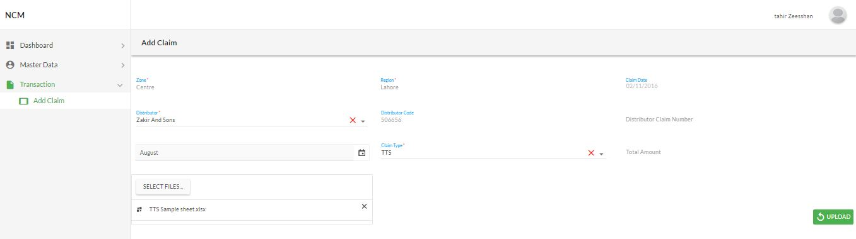
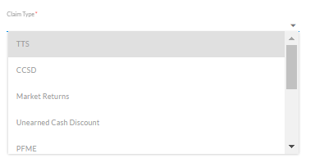
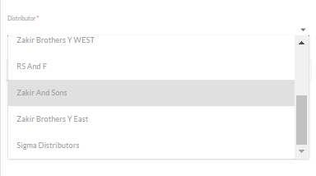
SOE is responsible for PUnching the claims in the system
Click on transaction to open sub-menu
1
2
System will auto generate the codes and claim numbers
Then click on add claim that appears in the sub-menu
3
Select distribution
4
Select the type of Claim among the multiple types*
*The types of claims are elaborated in the appendix

Slide 4
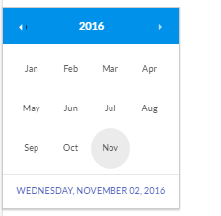
Selecting the Claim type
5
Select the reference file for claim as reference
6
Only the files excel files extracted from the system will be accepted for upload
Select the Month for which the claim is to be netered

Slide 5
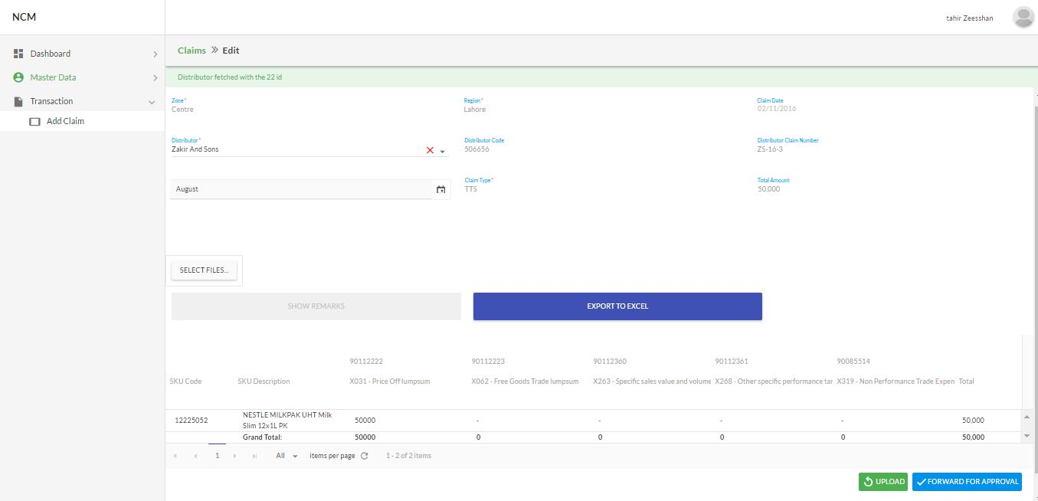
Uploading the file and Forward Claims against tts, rdc & market return
Once the files are opened upload the file can be replaced by select new files
7)
8)
Once the file is uploaded click upload.
The data will be updated in the tab according to the file.
Against once claim only one file will be uploaded and entertained.
Click on blue button to forward the claim to RSM for approval.
9)

Slide 6
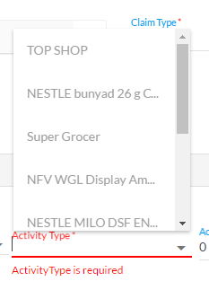
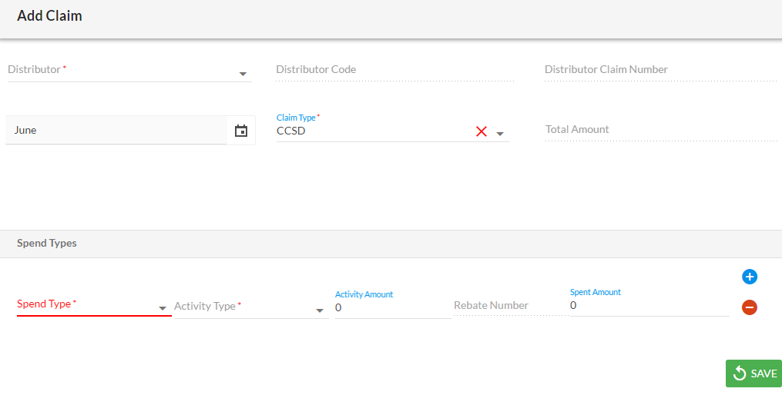
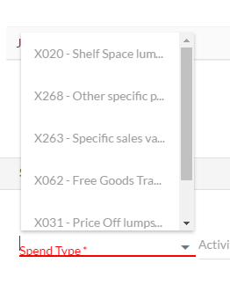
uploading file for claims against CCSD, unearned cash discount & Trade discount to key account
8)
The activity type will be pre-defined in the system by the master user depending on the
Spend type and on-going activities
Activity amount will be the spending done by distributor for the activity in one month
9)
10)
Rebate number will be auto generated against the spend and activity type
If the claim type is CCSD select from the spend type
Spend type is already predefined in the system by Master user.
7)

Slide 7
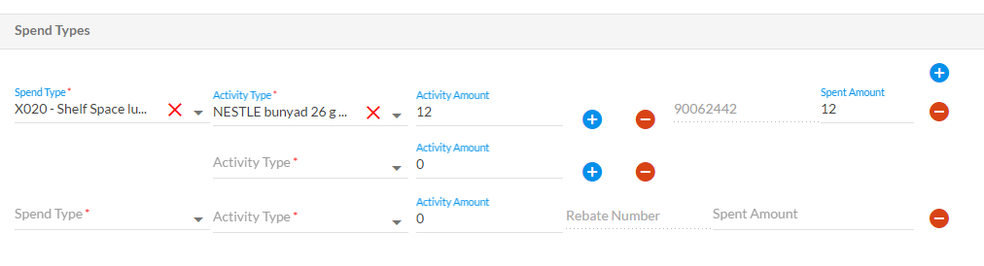
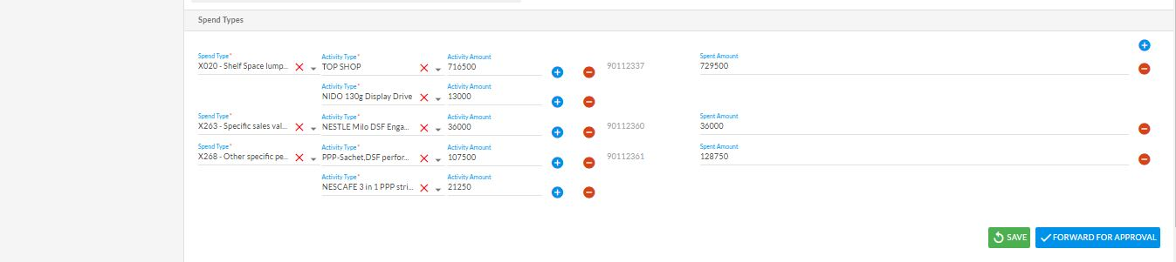
11
Multiple spent types could be added at one time for the claims against CCSD, unearned cash discount & Trade discount to key account
12
Multiple Activities could be added at one Spend type
13
Spent amount will be the sum of all the activities against the single spent type
14
Forward the claim for approval to the RSM

Slide 8
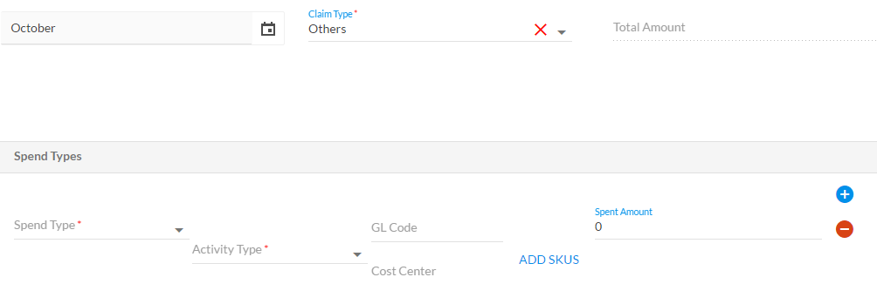
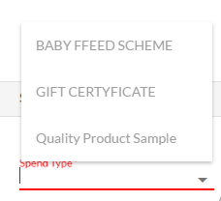
uploading file for claims against PFME, Others & Reconciliation adjustment
The CC and GL code has to be entered manually*
9)
11)
Multiple spent types could be added at one time for the claims
7)
The spend types will already be pre-defined in the system by master user
8)
The activity type will be pre-defined in the system by the master user depending on the
Spend type and on-going activities
10)
Manually select the SU from the drop down menu
12)
Forward the claim for approval to the RSM
*for PFME WBS number has to be entered

Slide 9
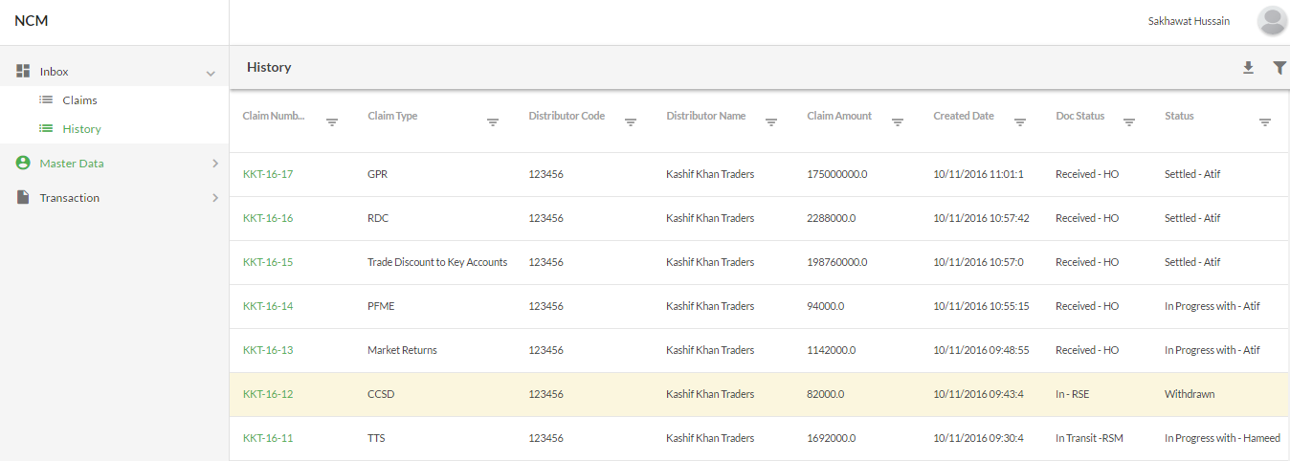
To check the status of claims submitted
10)
Click on history to see the status of the claims punched into the system

Slide 10
Claim Approval, rework or Withdrawal by Regional sales manager

Slide 11
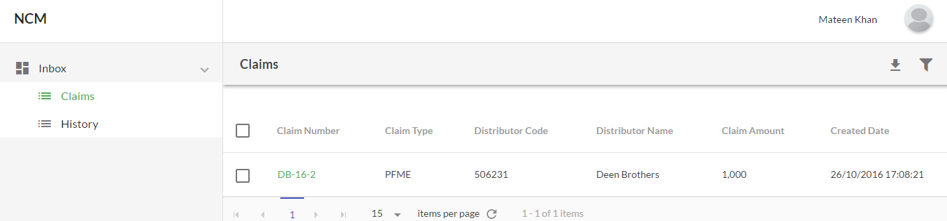
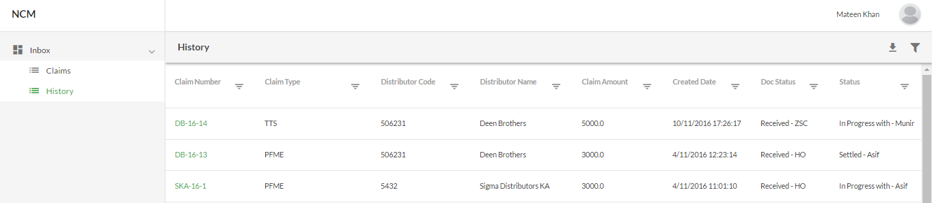
RSM is responsible for claim approval
1)
Click on inbox and then claim tab to see the claims pending for approval
2)
Details of the claims are visible here
3)
Details of the approved claims or those sent for rework or withdrawal along with their current status
4)
Click on history to see approved claims or those sent for rework or withdrawal

Slide 12
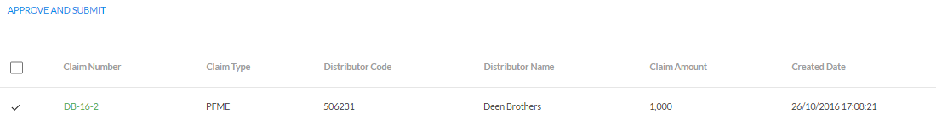
RSM is responsible for claim approval
6)
After selecting the claims just click approve and submit to forward the claims to ZSC
5)
Click on box next to claims and RSM can select multiple claims at one time OR click on claim number to view details

Slide 13
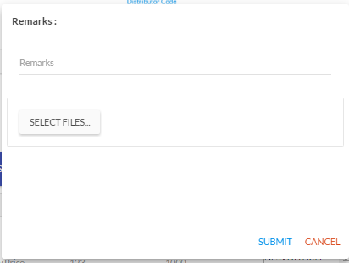
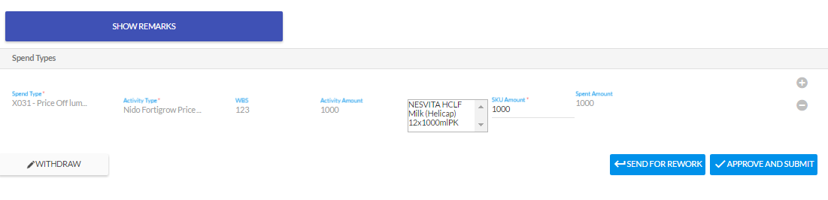
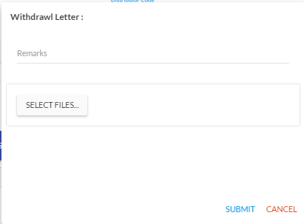
7)
9)
8)
RSM can approve the claim
RSM can send the claim to SOE for rework if discrepancy in values or description of the activity
RSM can withdraw the claim if he sees fit after attaching the letter from the distributor in PDF form

Slide 14
Claim Approval OR rework by Zonal Sales controller

Slide 15
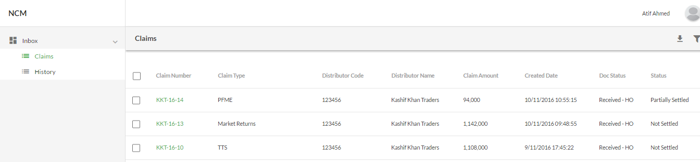
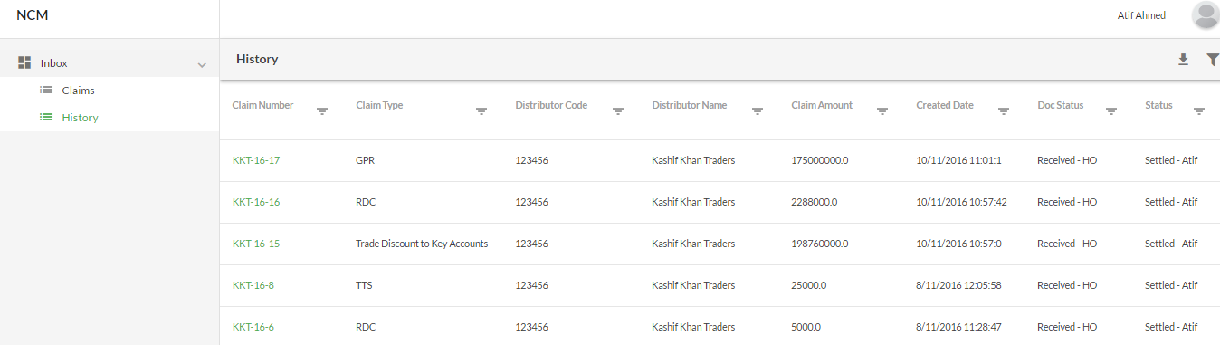
ZSC Can view the claims
1)
Click on inbox and then claim tab to see the claims pending for approval
2)
Details of the claims are visible here
3)
4)
Details of the approved claims or those sent for rework or withdrawal along with their current status
Click on history to see approved claims or those sent for rework or withdrawal

Slide 16
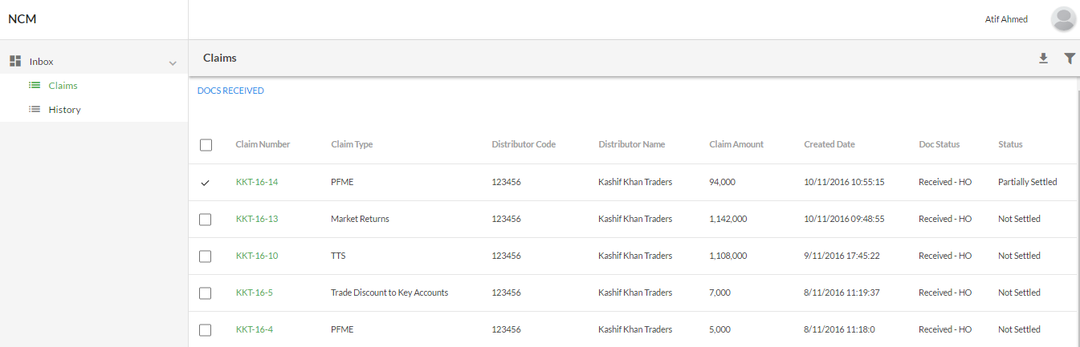
ZSC is responsible for receiving the Claims
Click on the box next to Claim and then click on docs received
5)
6)
Only after the docs are received they could be processed further

Slide 17
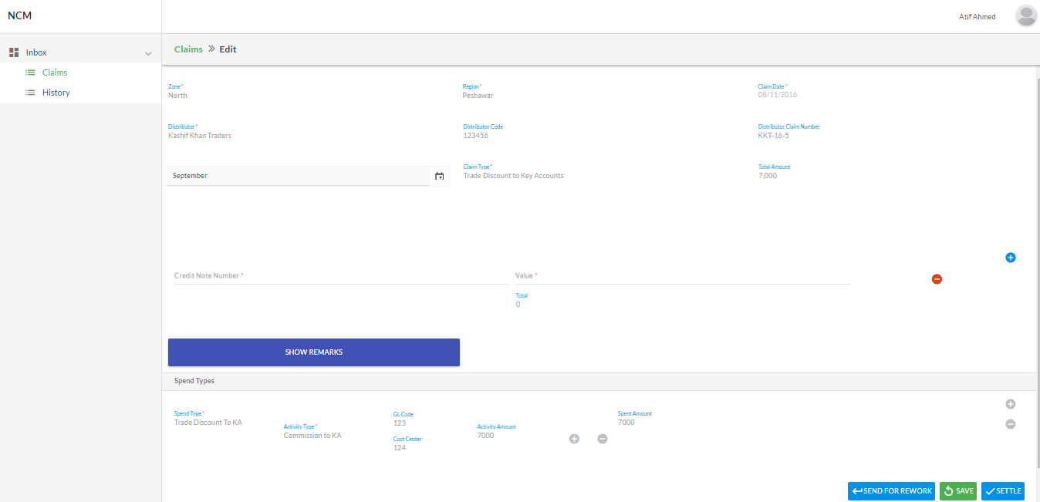
ZOC can approve the claim or send for rework
7)
Each claim has to be reviewed separately
If all the details match the claims can be approved and sent to ACR for final settlement
8)
9)
The claims could be sent for rework after attaching remarks

